Slide 1











FRACTIONAL KNAPSACK VISUALIZER
By: Sanya Jain (221030048)
Aashi Gupta (221030140)
Aditya Sharma (221030130)
Vansh Seth (221030133)

Slide 2
Problem Statement
Knapsack problem is one of the most common problem that occurs in daily life. From transporting non dispensible items to taking a simple shopping bag home you always want to maximize your output.
Our program helps you visualize the DP based solution for maximizing the profit. It helps you build the DP table by taking weight array, profit array for each item and maximum carryable weight as input. It also allows you to control the speed of animation as requirement.

Slide 3


Creation process
Planning:
Visualizing our day-to-day needs related to binary knapsack. E.g.- A simple Transportation system where we need to maximize the output.
Learning:
Efficient dynamic programming techniques for optimizing solutions to complex allocation problems.
Development:
Html, CSS , JavaScript and Binary Knapsack.

Slide 4
Technologies Used
01
02
03
04
HTML
CSS
JS
Bootstrap

Slide 5
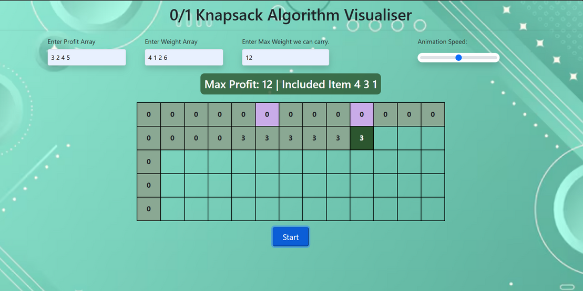
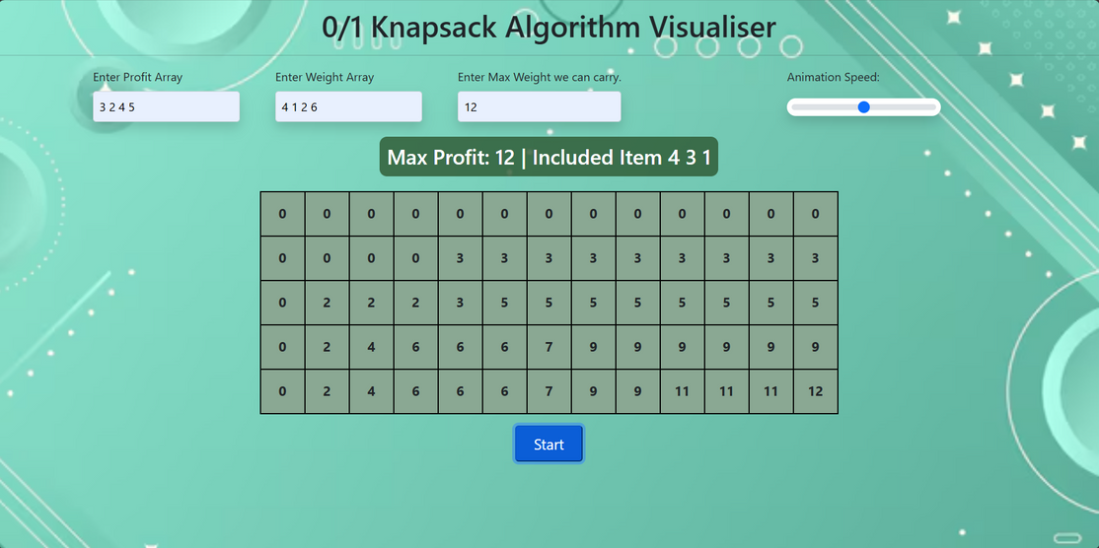
Output:

Slide 6
THANK YOU VERY MUCH!

